Slide 1

AMAZON.COM EMPLOYEE
ACCESS CHALLENGE
Predict an employee’s access needs, given his/her job role
Course : MIS 637 A (FALL 2014)
Department : Business Intelligence & Analytics
Prepared By : Naman Jain
Student ID : 10400308
Guided By : Prof. Mahmoud Daneshmand

Slide 2
OUTLINE
Introduction
Business Understanding
Method
CRISP-DM
Data Understanding
Sample Data
Attributes Description
Data Preparation
Missing Values
Attributes Transformation
Attribute Selection
Modeling
Input & Output attributes
Data Visualization
Training
Decision Tree
Decision Rules
Testing Set Results
Evaluation
Deployment
References

Slide 3
INTRODUCTION
When an employee at any company starts work ,they first need to obtain the computer access necessary to fulfil their role. This access may allow an employee to read/manipulate resources through various applications or web portals. A knowledgeable supervisor then takes time to manually grant the needed access in order to overcome access obstacles. As employees move throughout the company, this access discovery/recovery cycle wastes a nontrivial amount of time and money.
There is considerable amount of data regarding an employee’s role within an organization and the resources to which they have access. Given the data related to current employees and their provisioned access, models can be built that automatically determine access privileges as employees enter and leave roles within a company. These auto-access models seek to minimize the human involvement required to grant or revoke employee access.

Slide 4
BUSINESS UNDERSTANDING
Profound Question
Can we build a model, learned using historical data, that will determine an employee’s access needs, such that manual access transactions(grants and revokes) are minimized as the employee’s attributes change over time. The model will take an employee’s role information and a resource code and will return whether or not access should be granted ?

Slide 5
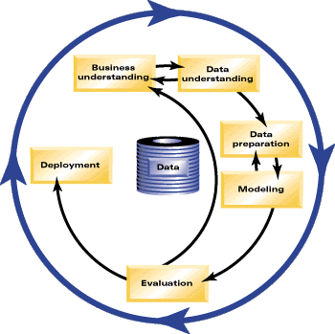
CRISP-DM
CRISP-DM(Cross Industry Standard Process for Data Mining) is a data mining process model that describes commonly used approaches that data miners use to tackle problems. There are 6 phases:
Business Understanding
Determine the business objective
Assess the situation and determine
the data mining goals
Produce a project plan
Data Understanding
Collect data and describe it
Explore and verify data quality

Slide 6
CRISP-DM(CONTD.)
Data Preparation
Check for missing values and outliers
Construct, integrate and format the data for analysis
Modeling
Select data modeling technique and generate test design
Build models and assess the model
Evaluation
Evaluate the model
Determine success rate of model
Does model meet project objectives?
Deployment
Plan the depolyment
Plan monitoring and maintenance
Produce final report

Slide 7
DATA UNDERSTANDING
DATA SOURCE:
The data consists of real historical data collected from 2010 & 2011. Employees are manually allowed or denied access to resources over time. An algorithm capable of learning from this historical data to predict approval/denial for an unseen set of employees must be created.
The data was obtained from www.Kaggle.com
DATA SET DETAILS:
The training data set consists of 30,872 records where ACTION is 1and 1,897 records where ACTION is 0 , therefore a total of 32,769 records. In addition, the test data set has 58,922 records.
Furthermore, the data set has 10 attributes. Out of which 9 are Independent attributes and 1 is the Target attribute.

Slide 8
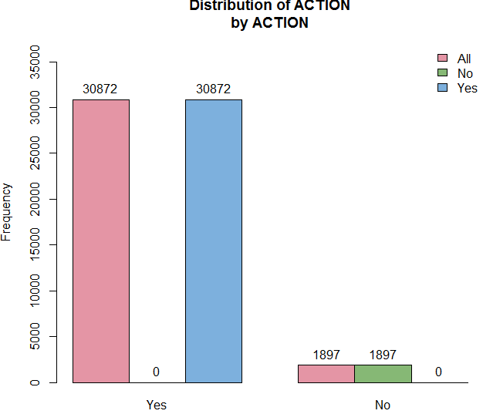
DATA UNDERSTANDING
Distribution of Yes and No in the target variable ACTION

Slide 9
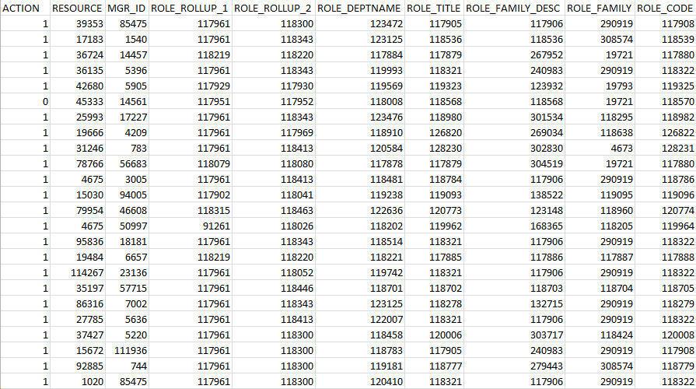
SAMPLE DATA

Slide 10
ATTRIBUTES DESCRIPTION
ACTION : ACTION is 1 if the resource was approved, 0 if the resource was not
RESOURCE : An ID for each resource
MGR_ID : The EMPLOYEE ID of the manager of the current EMPLOYEE ID record ; an employee may have only one manager at a time
ROLE_ROLLUP_1 : Company role grouping category id 1(e.g. US Engineering)
ROLE_ROLLUP_2 : Company role grouping category id 2(e.g. US Retail)

Slide 11
ATTRIBUTES DESCRIPTION
ROLE_DEPTNAME : Company role department description(e.g. Retail)
ROLE_TITLE : Company role business title description(e.g. Senior Engineering Retail Manager)
ROLE_FAMILY_DESC : Company role family extended description(e.g. Retail Manager, Software Engineering)
ROLE_FAMILY : Company role family description(e.g. Retail Manager)
ROLE_CODE : Company role code ; this code is unique to each role(e.g. Manager)

Slide 12
DATA PREPARATION
For data preparation the data set will be cleansed and transformed.
The data set is reviewed for the following:
Handle Missing values and Outliers, if any
Look for attributes that might need transformation
Select attributes appropriate for analysis

Slide 13
DATA PREPARATION
Missing Values :
The data set does not have any missing values.
Outliers :
There are many outliers in the data set, but it does not make sense to delete them as these are the ID’s of the employees.

Slide 14
DATA PREPARATION
Attributes Transformation
The target attribute ACTION has two combinational values (0 and 1).
The data set explains 1 if the resource was approved and 0 otherwise.
So the target attribute is transformed as follows :
Records with ACTION value 0 are coded as No.
Records with ACTION value 1 are coded as Yes.
This transformation helps in easier classification of data.

Slide 15
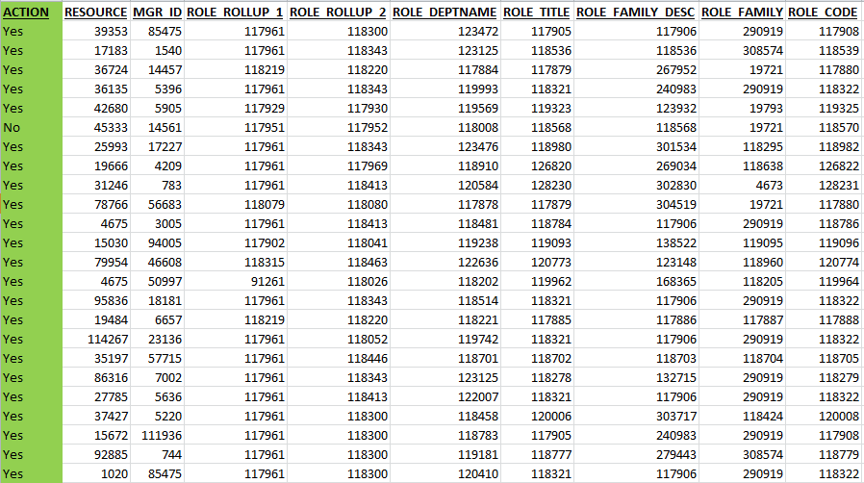
DATA PREPARATION
Attributes Transformation :

Slide 16
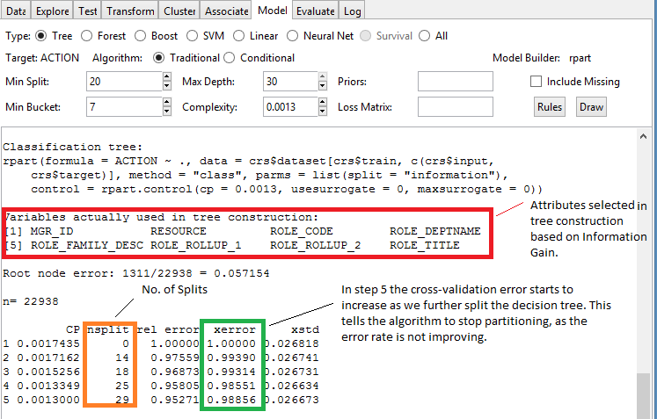
DATA PREPARATION
Attributes Selection: RATTLE is used to select attributes
A total of 8 attributes got selected based on Information Gain.

Slide 17
DATA PREPARATION
Data Division :
The training data set consisting of 32,769 records is divided into 2 sets.
Training data set is used to develop the model. 70% of the data is used in this set.
Testing data, developed using 30% of the training data is used to evaluate the model.
The model is also scored and tested on the separate 58,921 records.

Slide 18
MODELING
Software Used
Rattle(R Data Miner), version 3.3.0 is a graphical interface to R. It provides a Gnome(RGtk2) based interface to R functionality for data mining.
Machine Learning Technique
The main objective here is to build a model using historical data to predict approval/denial for an unseen set of employees, and derive rules for the same.
So the approach of Recursive Partitioning best fits here, since it splits the data into finer and finer subsets(recursively) resulting in a decision tree.
Also, since the target variable is categorical (Yes-approved ; No-denied) CART algorithm seems to be appropriate choice for the problem.

Slide 19
MODELING
INPUT ATTRIBUTES
OUTPUT ATTRIBUTE
RESOURCE
MGR_ID
ROLE_ROLLUP_1
ROLE_ROLLUP_2
ROLE_DEPTNAME
ROLE_TITLE
ROLE_FAMILY_DESC
ROLE_FAMILY
ROLE_CODE
ACTION

Slide 20
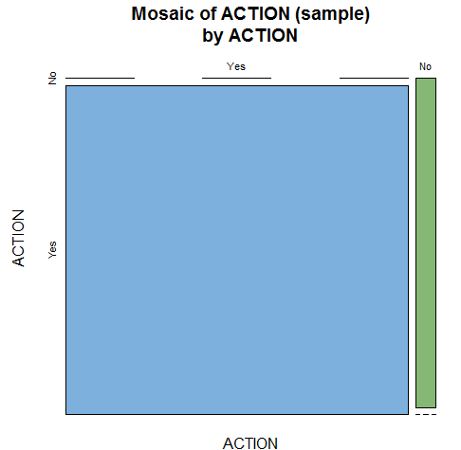
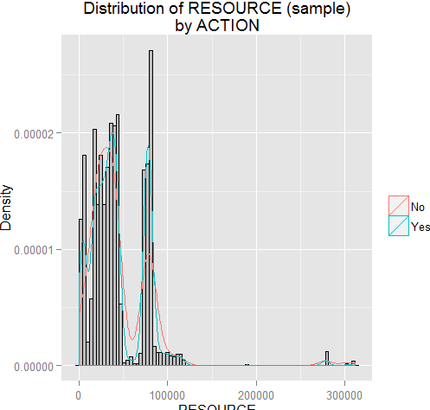
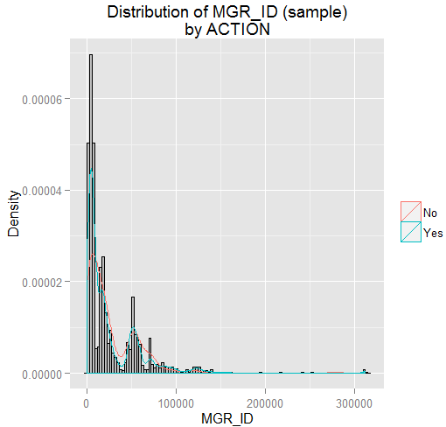
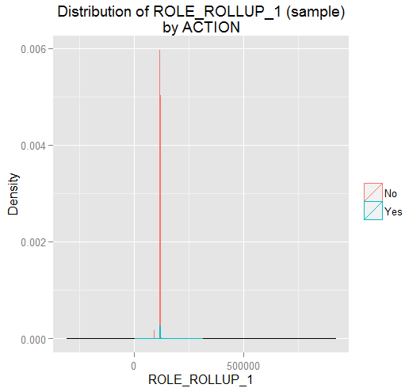
DATA VISUALIZATION
Modeling

Slide 21
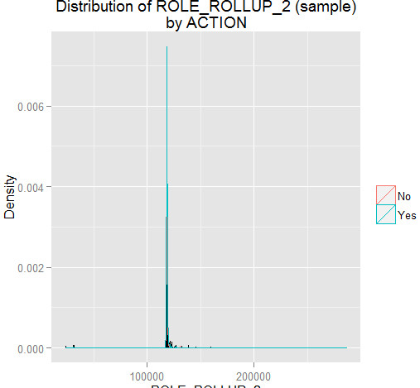
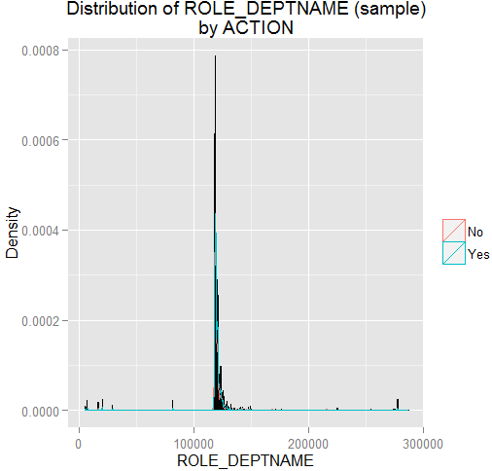
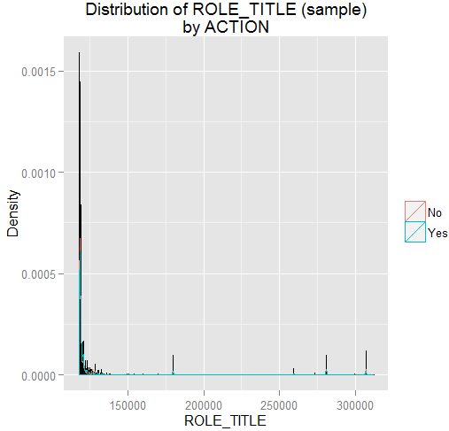
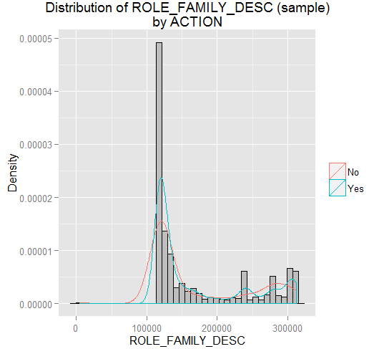
DATA VISUALIZATION
Modeling

Slide 22
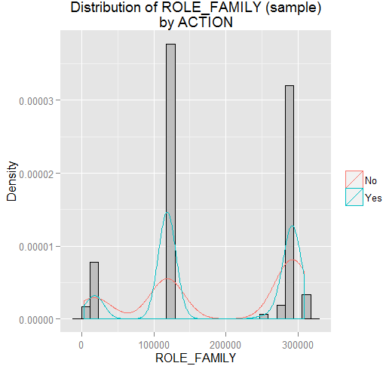
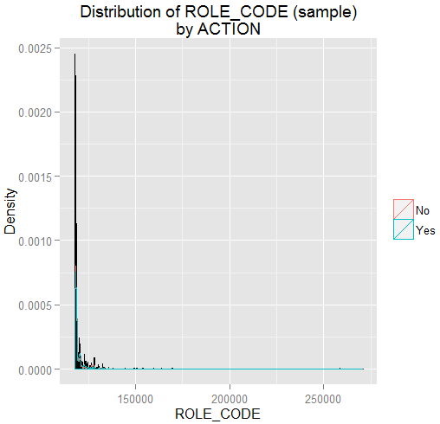
DATA VISUALIZATION
Modeling

Slide 23
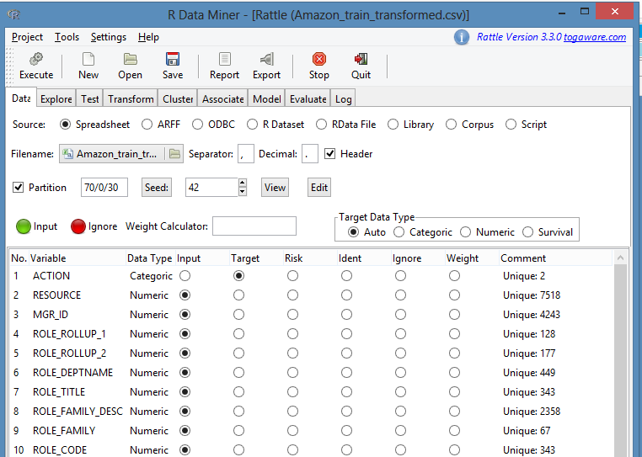
TRAINING
Modeling
Using Rattle, the model
is trained.
Target variable ACTION
is categorical, and
9 independent variables
are numeric.

Slide 24
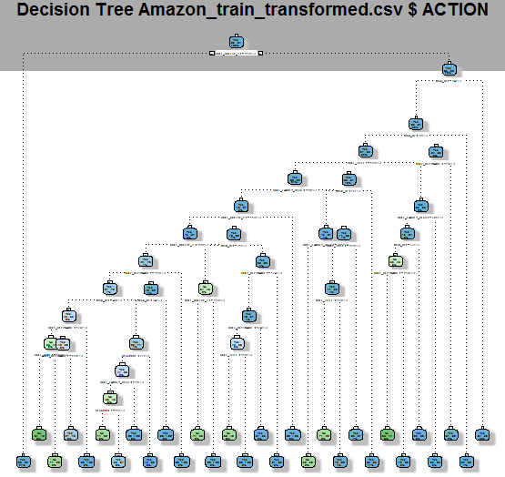
DECISION TREE
Modeling

Slide 25
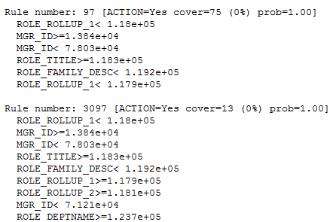
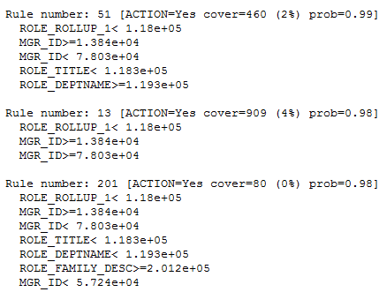
DECISION RULES
Modeling

Slide 26
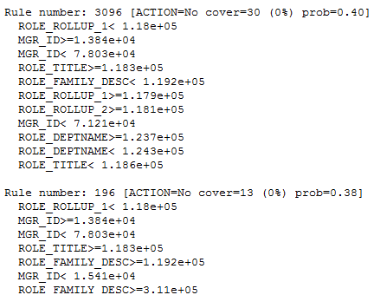
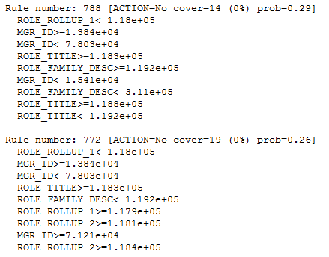
DECISION RULES(CONTD.)
Modeling

Slide 27
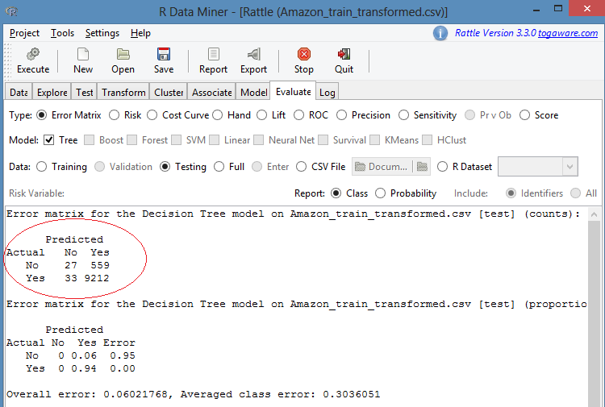
TESTING SET RESULTS
Modeling
Scoring on 30% of the test data from the training set.
Correctly classified instances = (9212+27)/9831= 9239 /9831 = 94%
Incorrectly classified instances = (33+559)/9831= 592/9831 = 6%
True Positives/Sensitivity/Recall , TP / (TP +FN) = 99.6%
True Negatives/Specificity , TN / (TN+FP) = 4.6%

Slide 28
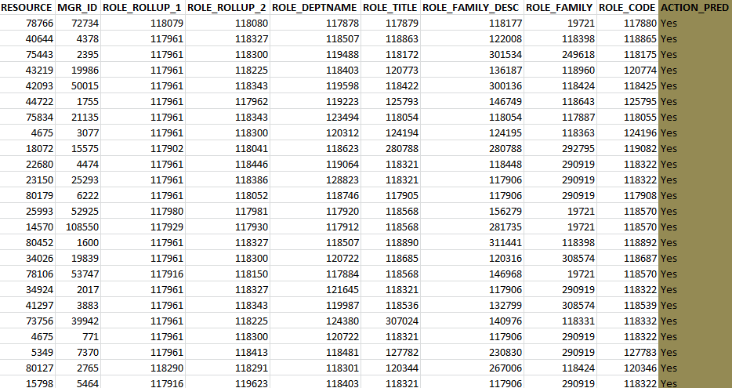
TESTING SET RESULTS
Modeling
Scoring Results on separate Test data set consisting of 58,921 records.

Slide 29
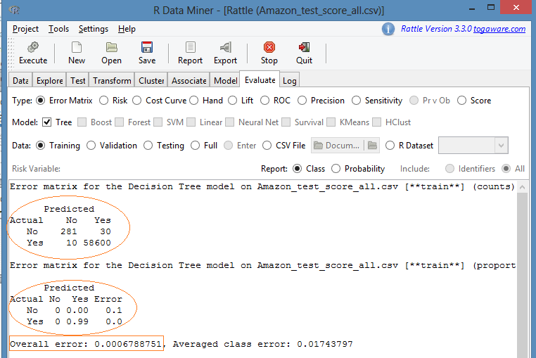
TESTING SET RESULTS
Modeling
Correctly classified instances = (58600+281) /58921=58881/58921 = 99.93%
Incorrectly classified instances = (30+10)/58921 = 40 /58921 = 0.7%
True Positives/Sensitivity/Recall , TP / (TP +FN) = 99.98%
True Negatives/Specificity , TN / (TN+FP) = 90.35%
= 9%

Slide 30
EVALUATION
We could see from the training data, test data and the decision tree that the attributes RESOURCE, MGR_ID, ROLE_ROLLUP_1, ROLE_ROLLUP_2, ROLE_DEPTNAME, ROLE_TITLE, ROLE_FAMILY_DESC, ROLE_CODE are the important factors predicting the ACTION.
From our model and analysis we were able to make good predictions on the basis of the key attributes.
The success rate on the separate test data set consisting of 58,921 records is 99.93%

Slide 31
DEPLOYMENT
This is the final phase of the phase of the CRISP-DM process. Here we will use the Model created and perform deployment.
After evaluating the results obtained from the model, in the previous phase, depolyment would be executed on a small set of data to ensure success of model.
Simple report of results will be provided and the results will be checked to verify success. The deliverables will be compared against the expected goal as discussed during the Business Understanding phase.
Finally the model execution instructions will be provided to the companies , who can now utilize the model to automate the employee access process such that manual access transactions are minimized.

Slide 32

REFERENCES
Discovering Knowledge in Data :
An Introduction to Data Mining,
By Daniel T. Larose
Data Mining with Rattle and R
By Graham Williams
Lecture Notes and Slides
http://rattle.togaware.com/
https://www.kaggle.com

Slide 33
Thank You!

